Slide 1
Model and Data Based Approaches to the Control of Tensegrity Robots
Ran Wang, Raman Goyal, Suman Chakravorty, Robert E. Skelton
Department of Aerospace Engineering, Texas A&M University, College Station TX, 77840

Slide 2
Motivation

Slide 3
Develop Soft Body Robots
Tensegrity Structure
Design Control Policy for Such Robots
Model-based Shape Control
D2C Algorithm

Slide 4
Tasks

Slide 5
Model the tensegrity structure and solve for a model-based control policy that drives the system from source to target
Apply the proposed model-free optimal control algorithm D2C to solve for a closed-loop control policy for the same task
Compare the D2C algorithm with the model-based shape control method

Slide 6
Formulation & Algorithm

Slide 7

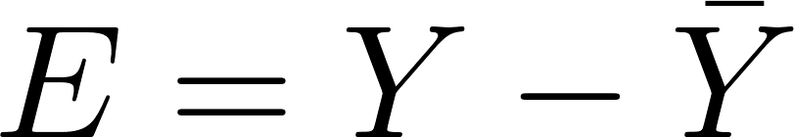
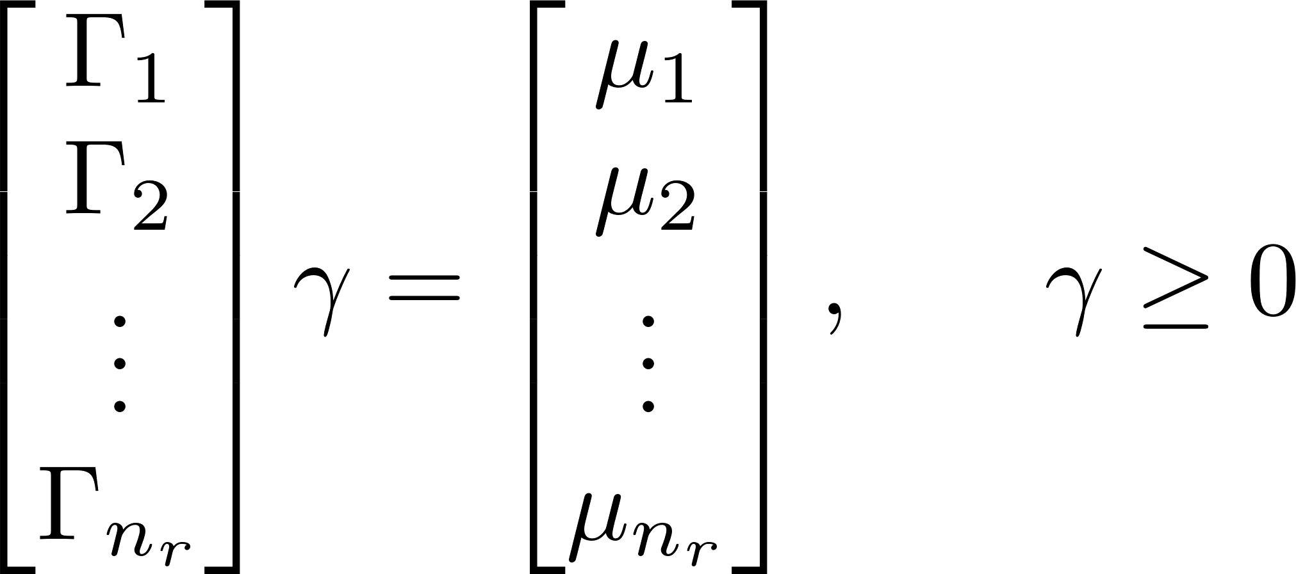
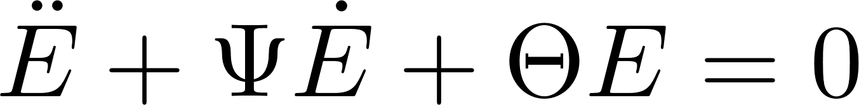
Modeling and Model-based Control for Tensegrity Structure
Dynamics Model for Class-k Tensegrity Structure:
Reduced-order Model :
Model-based shape control design:

Slide 8
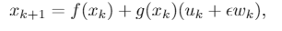
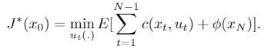
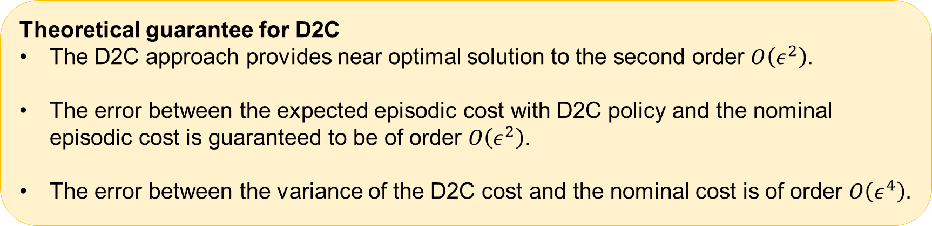
Decoupled Data-based Control (D2C) Algorithm
For the nonlinear stochastic system:
Solve the optimal control problem:
Theoretical guarantee for D2C
The D2C approach provides near optimal solution to the second order $O\left(ε^{2}\right)$.
The error between the expected episodic cost with D2C policy and the nominal episodic cost is guaranteed to be of order $O\left(ε^{2}\right)$.
The error between the variance of the D2C cost and the nominal cost is of order $O\left(ε^{4}\right)$.

Slide 9
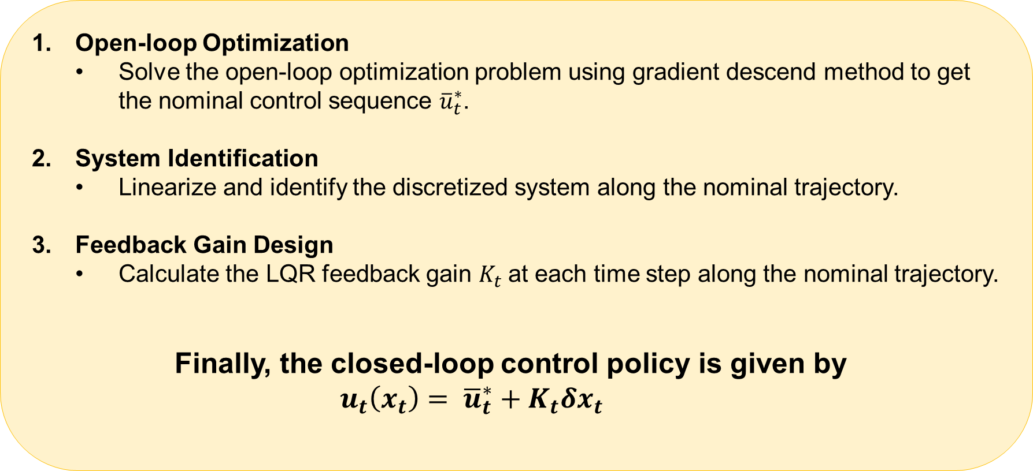
Decoupled Data-based Control (D2C) Algorithm
Open-loop Optimization
Solve the open-loop optimization problem using gradient descend method to get the nominal control sequence ${\overline{u}}_{t}^{∗}$.
System Identification
Linearize and identify the discretized system along the nominal trajectory.
Feedback Gain Design
Calculate the LQR feedback gain $K_{t}$at each time step along the nominal trajectory.
Finally, the closed-loop control policy is given by
$u_{t}\left(x_{t}\right)= {\overline{u}}_{t}^{∗}+K_{t}δx_{t}$

Slide 10
Experimental Results

Slide 11
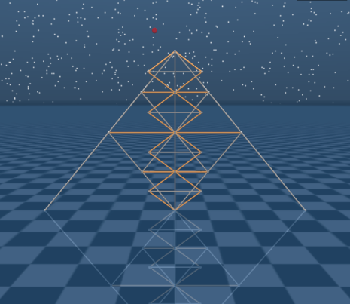
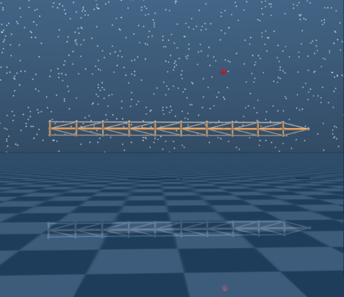
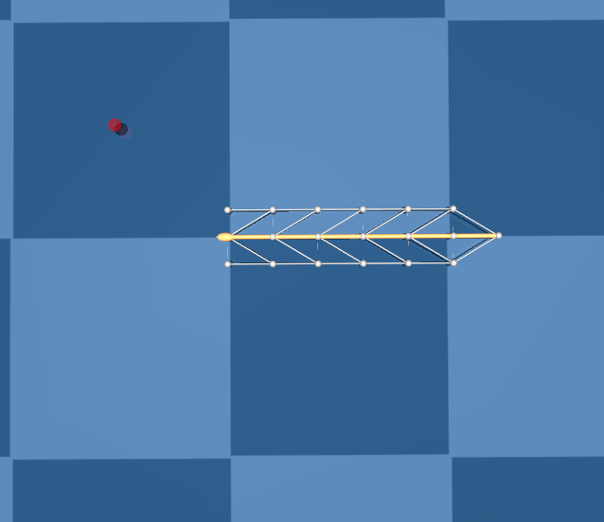
Tested Tensegrity Models
T2D1 Reacher: A 2-dimensional model built by combining 22 bars and 22 strings. It has 14 degrees of freedom and 22 control channels on the strings. The task is to move the top tip into the target.
Arm: A 2-dimensional robotic arm composed of 10 T-bar elements. It has 9 degrees of freedom and 38 control channels.
6-link Swimmer: This model is required to swim into the target. It’s a planner model that has 8 degrees of freedom and 22 control channels.

Slide 12
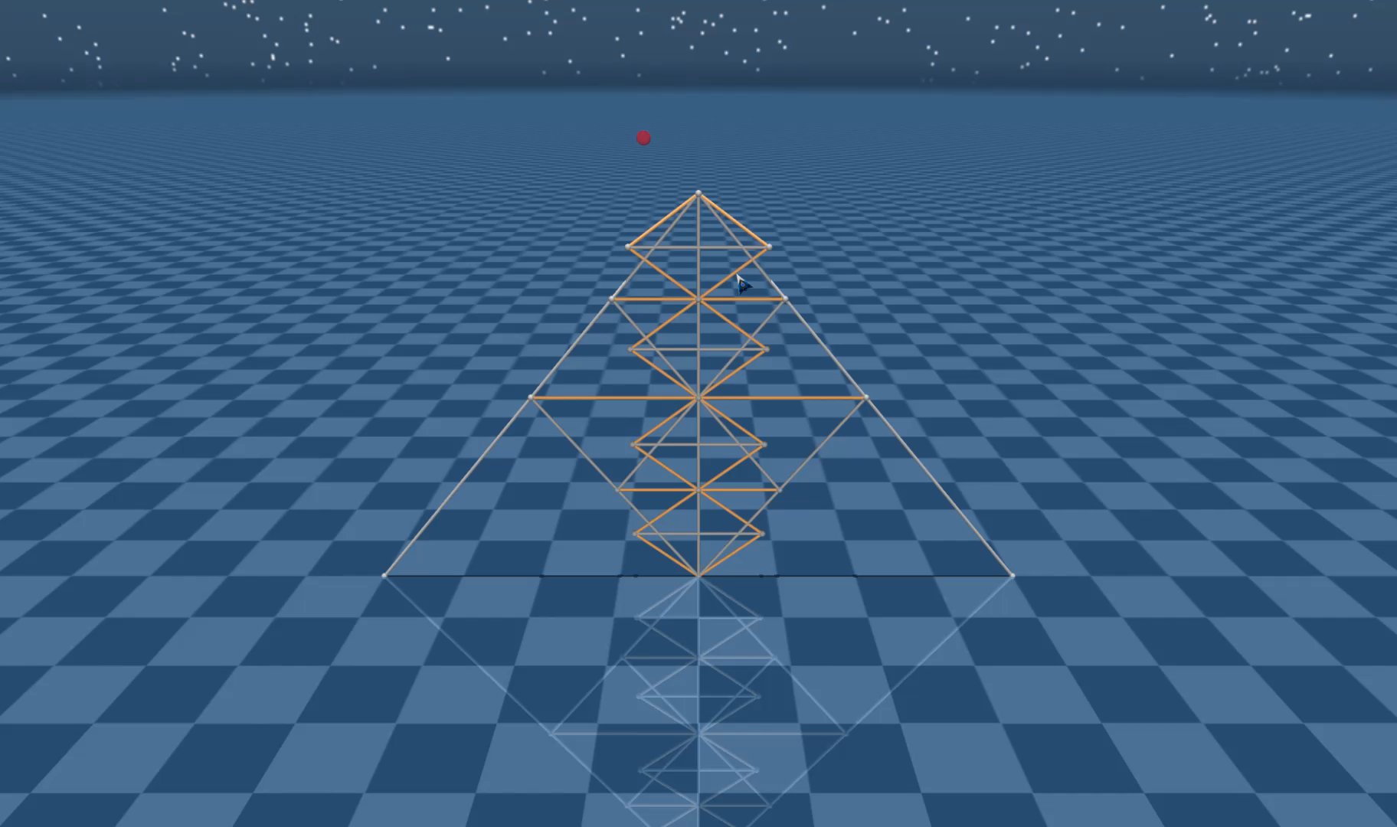
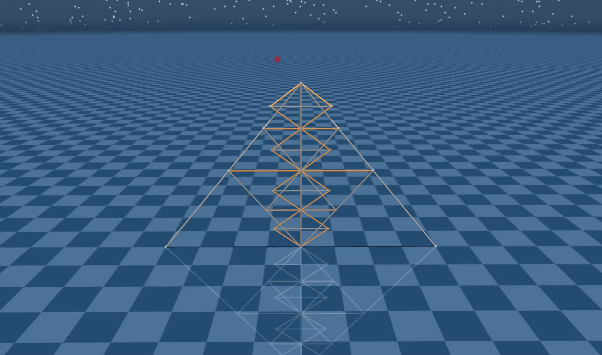
Model-based policy VS. D2C closed-loop policy
T2D1 Tensegrity Model
Red ball: Target
Faster
Slower
Model-based shape control
D2C closed-loop policy

Slide 13
Model based control
Moves faster
D2C
Moves slower
Both the model-based control and D2C succeed

Slide 14
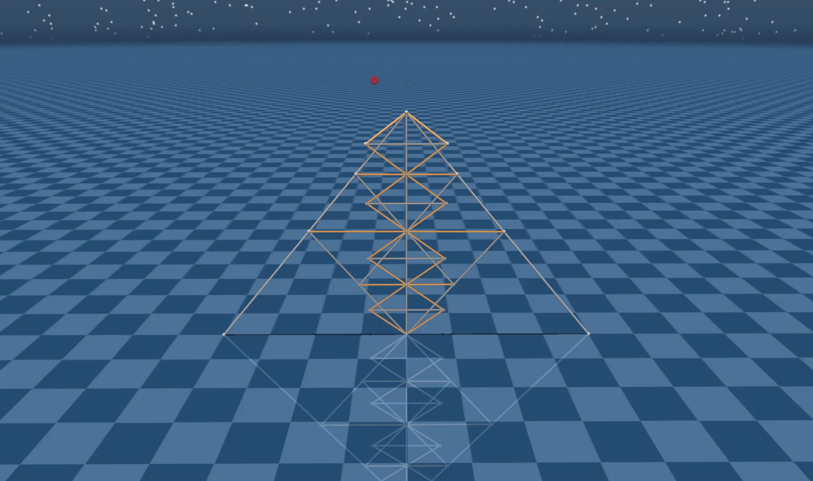
D2C applied on T2D1 Tensegrity Model
Noise level: 20%
Red ball: Target
Failed
Succeeded
D2C open-loop policy (no feedback)
D2C closed-loop policy

Slide 15
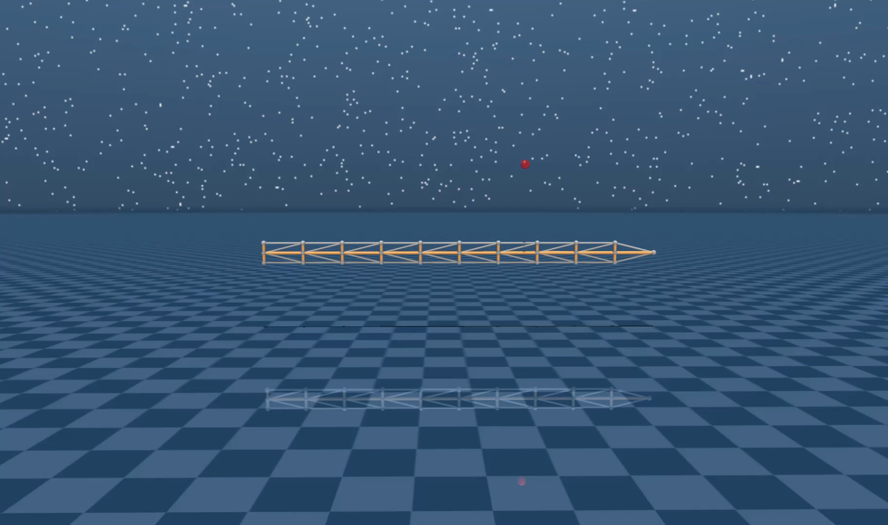
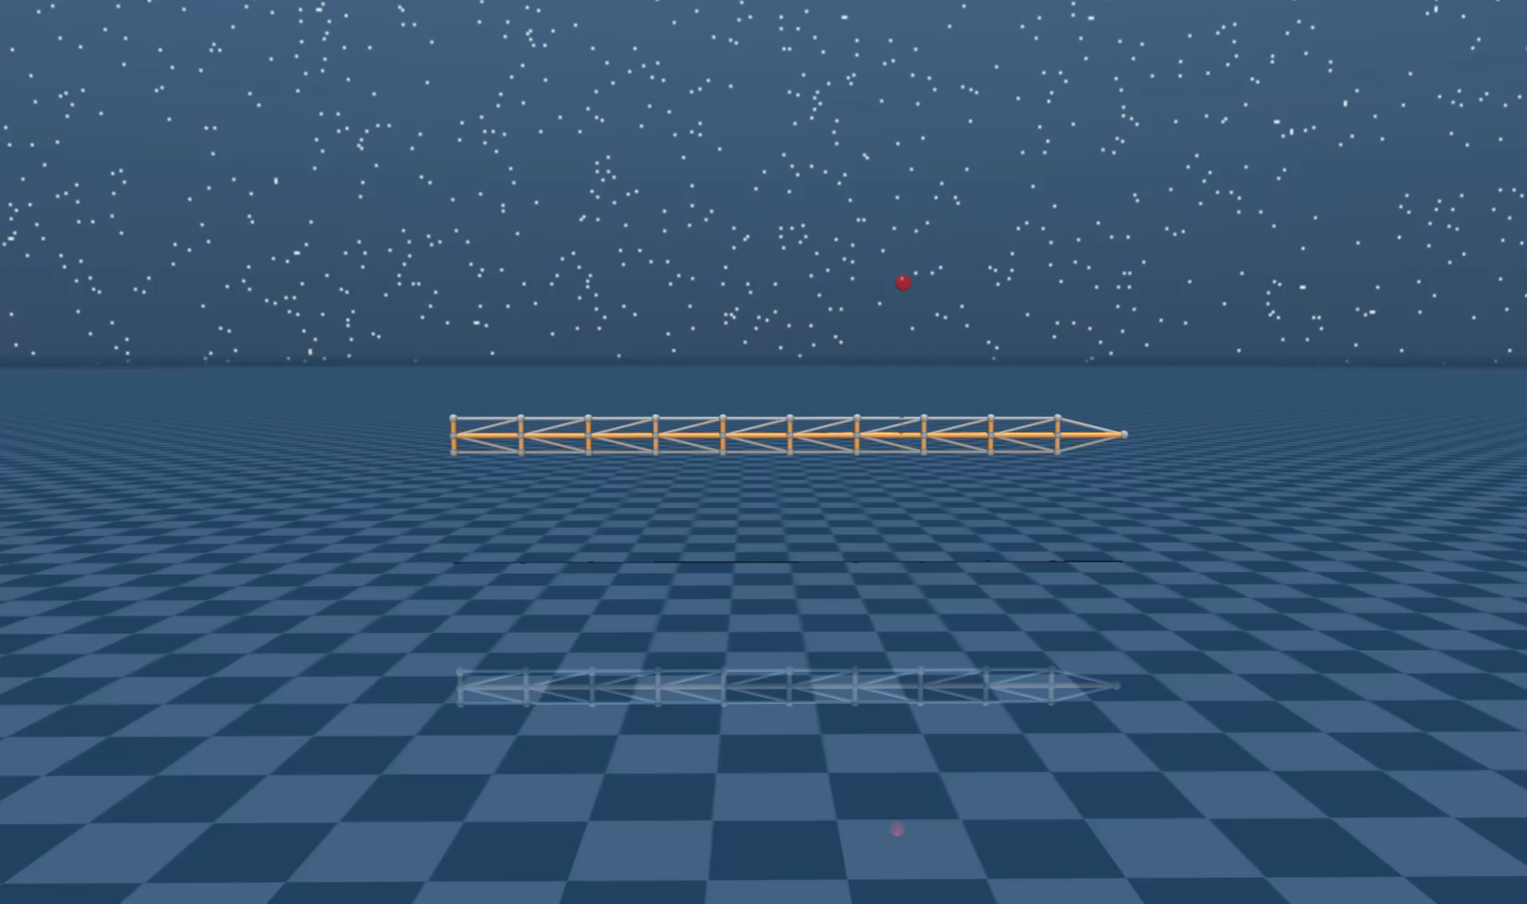
D2C applied on Robotic Arm Model
Noise level: 20%
Red ball: Target
Failed
Succeeded
D2C open-loop policy (no feedback)
D2C closed-loop policy

Slide 16
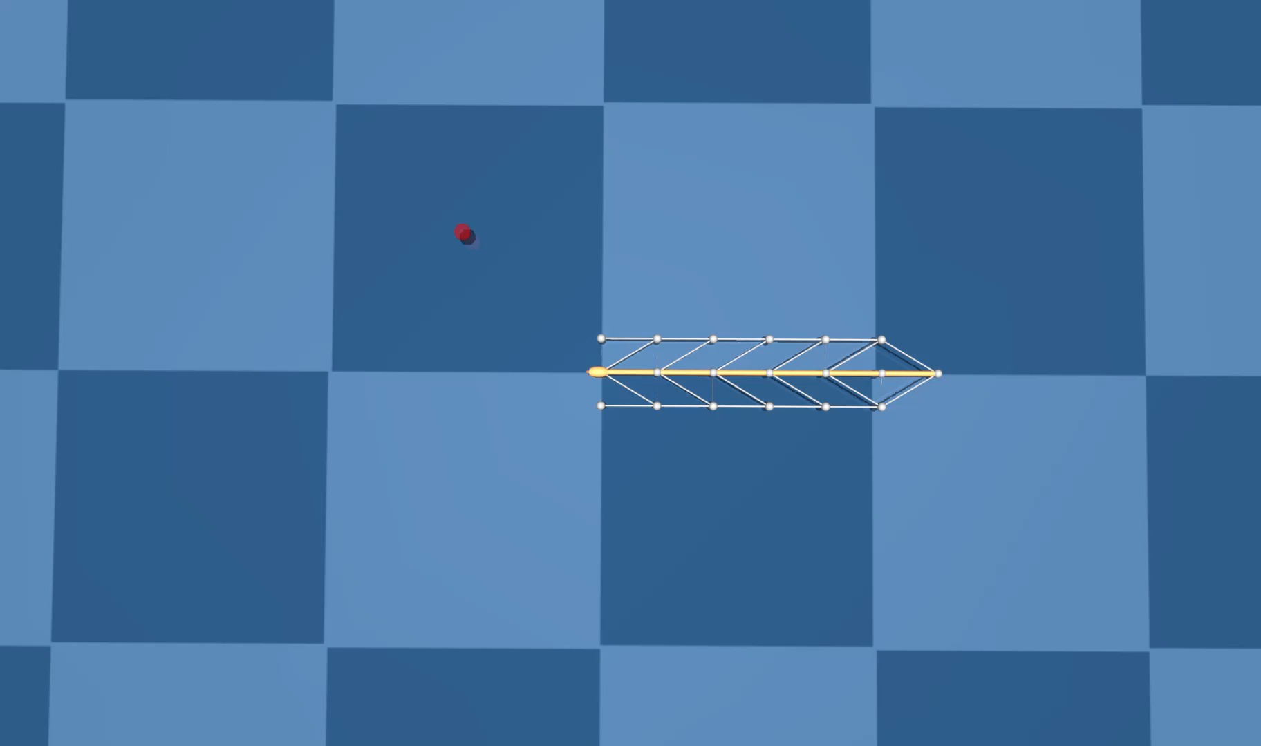

D2C applied on 6-link swimmer model
Noise level: 20%
Red ball: Target
Failed
Succeeded
D2C open-loop policy (no feedback)
D2C closed-loop policy

Slide 17
Open-loop policy under noise
Unable to reach the target
Closed-loop policy under noise
Can reach the target
Proves the success for the D2C algorithm

Slide 18
Both the model-based shape control and D2C can drive the system to the target
Model-based shape control
Faster motion
Larger control effort
Closer to the target
Accuracy
Negligible training time
D2C
Less control effort
Optimization
Comparable accuracy
No need for model

